Slide 1
Announcements
StockTrak starts this week. Start forming teams. More details next class.
CQA Investment Challenge
Starts the end of October
The Challenge provides teams with first-hand experience of being a portfolio manager by managing money, explaining their investment process and discussing performance. Teams will handle all aspects of portfolio management including stock selection, portfolio construction, and risk management. In addition, teams are required to complete a video presentation that provides a review of their investment team, investment philosophy/process as well as an update on performance. Throughout the competition teams will work with an assigned CQA member who will serve as a mentor and guide. The Challenge is an invaluable real-life view into managing money in the investment management industry.
More information on Canvas. Uses the StockTrak platform.
http://www.cqa.org/investment_challenge

Slide 2
Risk and Return
Notes:
10 Minutes

Slide 3
Investing
Goal: create a portfolio of assets with the “optimal” trade-off between return and risk
What are some ways to minimize our risk?
Invest in “safe” assets
Diversify – build a portfolio of assets
Diversify across risk factors
What are some ways to maximize our returns?
Invest in “riskier” assets – in equilibrium they should demand higher risk premiums
Find mispriced securities and take advantage of mispricing

Slide 4
Plan
In future classes:
We’ll learn some methods for finding the right balance between risk and return in our investment portfolio
Today:
We’ll discuss returns and some of the risks investors care about

Slide 5
Returns

Slide 6
Holding Period Return
The overall performance of our investment over a certain period of time
If we buy a security at time 0 and sell at time T, then our holding period return is:
The HPR for a stock is calculated:

Slide 7
Risk and Returns
Almost all investments are risky
I.e., we don’t know what the HPR will be with certainty
When we invest, we have to ask ourselves “How are returns distributed?”
Notes:
Monthly returns on the Wilshire 5000 (all stocks actively traded in the U.S.) only 3,691 components

Slide 8
Risk
Usually, we prefer:
Less variation in our returns
To avoid losing money (especially large losses)
To avoid losing money in bad times especially
Many different risk measures
Variance and standard deviation
Skewness and kurtosis
Value-at-risk

Slide 9
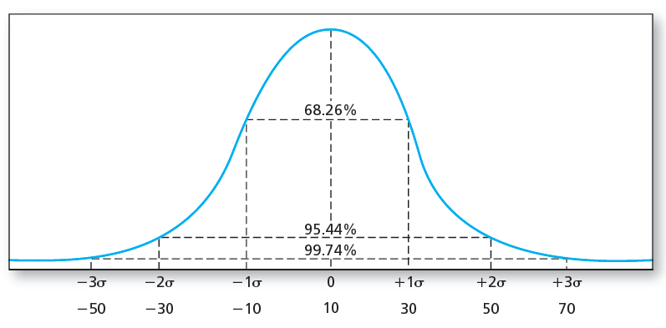
Normal Distribution
Standard deviation is a good measure of risk when returns are symmetric
Variance and standard deviation are informative of the spread in returns
Notation:
Figure:
Notes:
If security returns are symmetric, portfolio returns will be as well

Slide 10
Formulas
s indicates the state of the world (e.g., good, bad neutral)
p(s) is the probability of state s
r(s) is the return in state s
Notes:
In reality, there is almost always an infinite number of possible states of the world

Slide 11
Scenario Analysis
If we are given the probability of each return possibility, we can calculate:
Expected return
Standard deviation (and variance) of returns
Scenarios example:
Return scenarios for the S&P 500 index
10% chance of recession: -5% return
70% chance of slow growth: 0% return
10% chance of moderate expansion: 5% return
10% chance of rapid expansion: 10% return

Slide 12
Risk and Return Example
You are planning to invest in the S&P 500 using an ETF
There is a 50% chance:
The next year will see an economic expansion
And the return on the ETF will be 10%
There is a 50% chance:
The next year will see an economic contraction
And the return on the ETF will be -5%
What is your expected return and the standard deviation of returns?
Notes:
Draw on board

Slide 13
Risk and Returns
50% chance of 10%, 50% chance of -5%
Notes:
Do on board

Slide 14
Risk and Return Example
Coca-Cola currently has a stock price of $39:
The distribution of prices in one month are:
What is your expected return and standard deviation of return?
Probability | Price
.25 | $45
.25 | $39
.50 | $37

Slide 15
Risk and Return Example
Probability | Price | Return
.25 | $45 | 6/39 = 15.38%
.25 | $39 | 0/39 = 0%
.50 | $37 | -2/30 = - 5.13%

Slide 16
Covariance
When optimizing a portfolio, we’ll want to consider the joint variability of assets.
E.g., do two securities’ move up and down together, in opposite directions, are they uncorrelated, etc.
Covariance is a measure of joint variability
Cov(X,Y) = E[(X – E[X])(Y-E[Y])]
Variance is a variable’s covariance with itself

Slide 17
Estimating the Return Distribution

Slide 18
Estimating the return distribution
We almost never know the exact distribution of returns for an asset or portfolio
Methods for estimating expected returns:
Use historical average returns
Fundamental analysis
E.g., MSFT is undervalued 10% and we expect it to achieve its fundamental price in 1 month
Asset pricing models based on riskiness of asset
E.g., the CAPM model, multi-factor models
Methods for estimating the standard deviation:
Historical standard deviation
Many other methods (GARCH, using textual analysis (?), etc.)

Slide 19
Issues with these methods
Historical average returns:
History doesn’t repeat itself…
Example: Amazon up 120,000% since it’s IPO. Roughly 5% per month average.
This is unlikely to be the case going forward
Fundamental analysis:
There is a lot of uncertainty surrounding our estimates – we may be completely wrong
Asset pricing models:
Lots of debate about which asset pricing model should be used…
We’ll discuss a lot more in future classes

Slide 20
Using Historical Data

Slide 21
Average Returns
Arithmetic average return
Geometric average return
I.e., what constant return “g” each period would give me the same ending amount

Slide 22
Example
Find the arithmetic and geometric average return on the S&P 500 for 2016:
Source: Ycharts.com
Notes:
(-0.12% + 3.56% +0.09% +1.53%+0.27%+6.60%+-0.41%+-5.07%)/8 = 0.80625%

Slide 23
Average Returns
Arithmetic average return:
(-0.12% + 3.56% +0.09% +1.53%+0.27%+6.60%+-0.41%+-5.07%)/8 = 0.81%
Geometric average return:
V_{T} = $1(1-0.0012) (1+.0356)(1+0.0009)(1+.0153)x (1+0.0027)(1+.0660)(1-0.0041)(1-.0507) = $1.06219
g = ($1.06219/$1)^{1/8} - 1 = 0.00757 = 0.757%

Slide 24
Average Returns Examples
Solve for the arithmetic and geometric average return if returns are:
Year 1 = 5%
Year 2 = 10%
Year 3 = -20%
Year 4 = 15%

Slide 25
Average Returns Examples
Solve for the arithmetic and geometric average return if returns are:
Arithmetic
(5+10-20+15)/4 = 2.5%
Geometric
[(1.05)x(1.10)x(0.80)x(1.15)]^{1/4}-1 = 1.53%

Slide 26
Historical Average Returns
Use arithmetic average return (not geometric) to estimate expected return
Law of large numbers tells us arithmetic converges to expected return

Slide 27
Estimating from data
Variance (unbiased estimate):
Covariance (unbiased estimate):

Slide 28
Average Returns

Slide 29
Standard deviations
Source: mfs.com
Notes:
https://www.mfs.com/wps/FileServerServlet?articleId=templatedata/internet/file/data/sales_tools/mfsp_20yrsa_fly&servletCommand=default

Slide 30
Converting to Annual Values
Notes:
Typically, we estimate average returns and standard deviation at higher frequencies than annual, but then convert them to annual values.

Slide 31
Converting to Annual Returns
How do we convert higher frequency returns to lower frequency returns?
E.g., convert monthly return to an annual return:
Strategy 1: multiply by the number of periods (ignore compounding)
E.g., if the expected monthly return on a stock is 1%, then the expected annual return is 12%.
Strategy 2: compound the return by the number of periods and subtract 1
E.g., if the expected monthly return on a stock is 1%, then the expected annual return is (1+.01)¹² – 1 = 12.68%

Slide 32
Converting Monthly to Annual
Variance:
Standard deviation:

Slide 33
Sharpe Ratio

Slide 34
Sharpe Ratio
Measure of reward-to-risk
Forward looking:
Historical:

Slide 35
Excess Returns
Most return analysis examines excess returns
Returns minus the risk-free rate
Expected excess return (aka “risk premium”):
Why focus on excess returns?

Slide 36
Example
Find the Sharpe ratio of REITS over the past 20 years
Average return on REITs was 9.8%
Average return on t-bills was 3%
Standard deviation of REIT returns was 19.47%
Sharpe = (0.098 - .03)/(.1947) = 0.35
Find the Sharpe ratio of large cap growth stocks over the past 20 years
Average return on a portfolio of large cap growth stocks was 8.3%
Standard deviation was 17.57%
Sharpe = (0.083 - .03)/(.1757) = 0.30

Slide 37
Other Risk Measures
Notes:
What risks do you care about as an investor?

Slide 38
Non-Normal
What if excess returns are not normally distributed?
Standard deviation is no longer a complete measure of risk
Need to consider other risk measures like skewness and kurtosis
Notes:
If expected return estimate is too large, then this compounds to a large sampling error
If expected return estimate is too small, then this compounds to a smaller sampling error

Slide 39
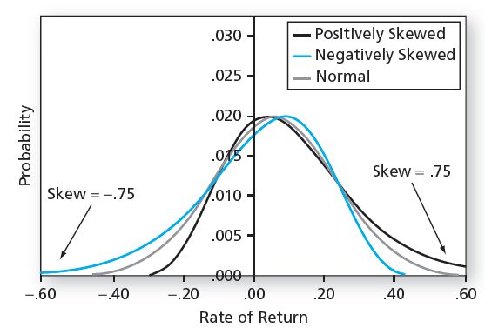
Skewness
Measure of asymmetry
Mean = 6%, SD = 17%
Normal distribution has skewness of 0
Skew<0 = negative skewness
Skew>0 = positive skewness

Slide 40
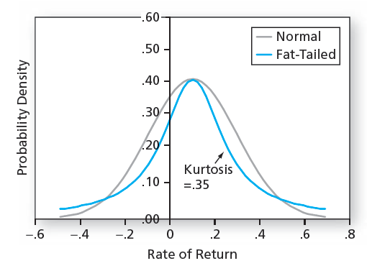
Kurtosis
Measure of “tailedness”
Mean= .1, SD = .2
Normal distribution has kurtosis of 0
Kurtosis>0 implies fatter tails, more outliers than the normal distribution
Notes:
Platykurtic less than 0
Leptokurtic greater than 0

Slide 41
Losses
Most investors tend to be more concerned with possible downside losses than upside gains

Slide 42
Value at Risk (VaR)
Loss corresponding to a very low percentile of the entire return distribution during a period, such as the fifth or first percentile return
Either in terms of returns or dollars
Examples:
Margin requirements are set in derivatives markets based on covering most losses
Banks will limit traders actions. They are usually limited by the size of possible losses.
Example: one day 5% VaR of -15%
Translation: 5% chance returns will be -15% or worse during a one-day holding period
Example: 30 day 1% VaR of $20M
Translation: there is a 1% chance the position will lose at least $20m in the 30-day period

Slide 43
How do we calculate VaR?
A number of ways:
1. If distribution is normal and you know mean and standard deviation, then VaR(%, normal) = Mean – ( Z x SD)
2. Historical simulation
3. Monte Carlo simulation
% | 10% | 5% | 1%
Z | 1.28 | 1.645 | 2.33
Notes:
Further discussion:
https://web.stanford.edu/class/msande444/2012/MS&E444_2012_Group2a.pdf

Slide 44
Other Risk Measures
Expected shortfall (ES)
Conditional on being in the bottom X% of returns, what is the expected loss
Focuses on the expected loss in the worst case scenario
Example:
“ES of $100 for 5% tail” means the expected loss is $100 conditional on being in the worst 5% of possible outcomes

Slide 45
Other Risk Measures
Lower Partial Standard Deviation (LPSD)
“Left-tail standard deviation”
Computed like the usual standard deviation, but using only those returns below the risk-free rate
Not concerned with frequency of “bad” returns
Just how volatile are negative returns

Slide 46
Sortino Ratio
Sharpe ratio with the LPSD instead of the standard deviation of excess returns

Slide 47
In Class Risk and Return Assignment

Slide 48
Appendix

Slide 49
Value at Risk and the VIX
The more volatility in markets, the more binding VaR constraints
Liquidity can decrease
Prices can decrease

Slide 50
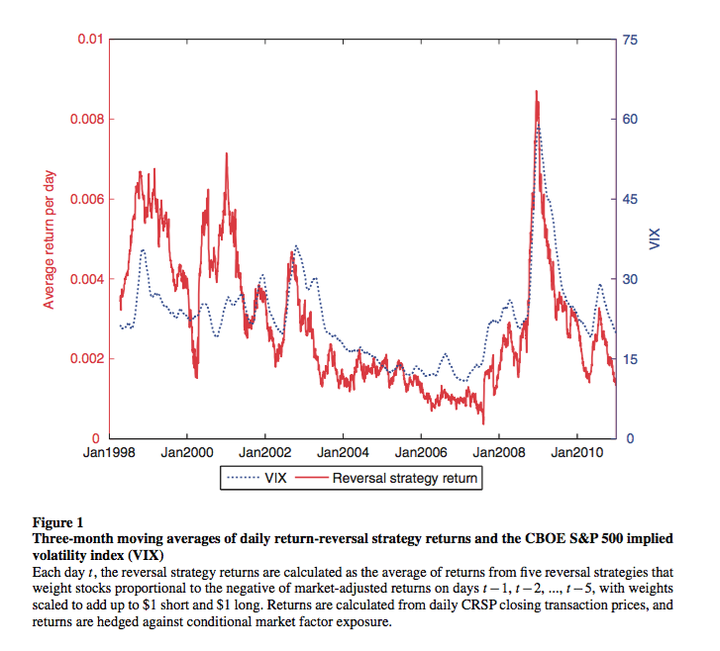
Liquidity and the VIX
Nagel 2012

Slide 51
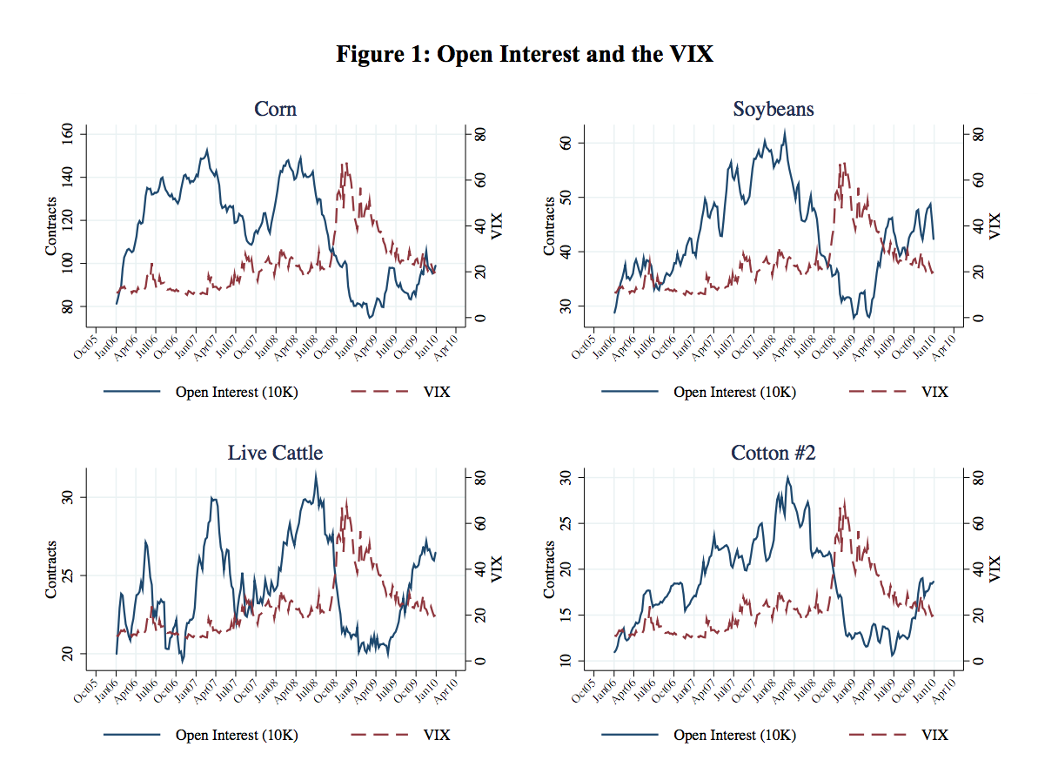
Commodities and the VIX

Slide 52
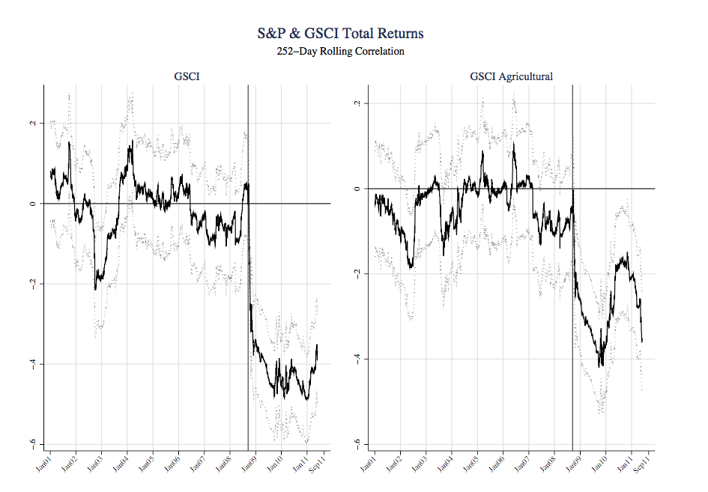
Commodities and the VIX

Slide 53
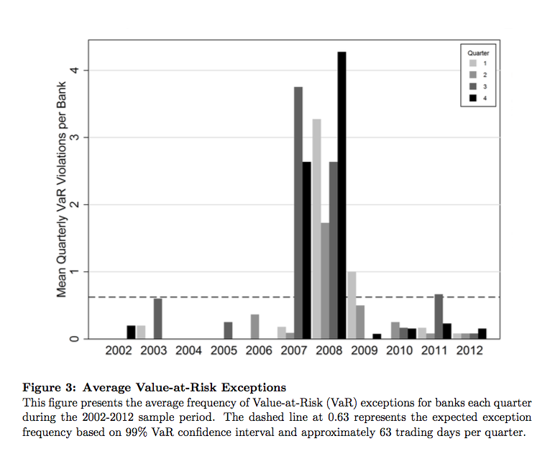
VaR in Crises
Notes:
A VaR exception occurs when a bank’s realized losses exceed its self-reported VaR number.

